Slide 1


Air Quality Monitoring System
Ideation Sprint | Year II & Semester IV
Student Name: ABILESH K S & Roll No: 20BEE001 Team
Student Name: AAKASH B & Roll No: 20BME001 Name: C2_Team_1
Student Name: ABINAYADEVI K & Roll No: 20BEC002
Student Name: AADHI SUBRAMANIYAM S & Roll No: 20BCE001 Mentor
Student Name: ABHAY MOHANAN & Roll No: 20BCS001 Name: VINOTH KUMAR
Student Name: ABISHEK M & Roll No: 20BTT001

Slide 2

Challenge
With the rising amount of pollution today, the quality of air is being compromised.
This causes various respiratory diseases in people who live in such areas.
To be aware of the condition of air in the room in which a person is present, an air quality sensor can be built that displays temperature, moisture, percentage of gases, etc.
Embedded and IoT | Air Quality Monitoring System

Slide 3
Significance
Due to the rapidly rising amount of air pollution, it has become a must for people to be aware of the quality of air around them.
By solving this problem, the beneficiaries will be able to become aware of this and take necessary measures to control the quality of air in their environment.
This in turn results in reduced case of diseases mainly respiratory diseases.

Slide 4


Target User
Hospitals due to the need for maintaining proper air quality for the safety of patients.
Public places with high density of people, like malls, theatre, schools and colleges, etc.
Industrial places to monitor the optimum conditions.
The current products available on the market are not affordable for most of the beneficiaries despite the air quality being a significant factor that contributes to the health of a person.
Use case
The effect of pollution is on the human health, and it therefore affects every person. So, it applies to most situations.
Specifically, it would be very helpful for patients suffering from respiratory diseases.

Slide 5
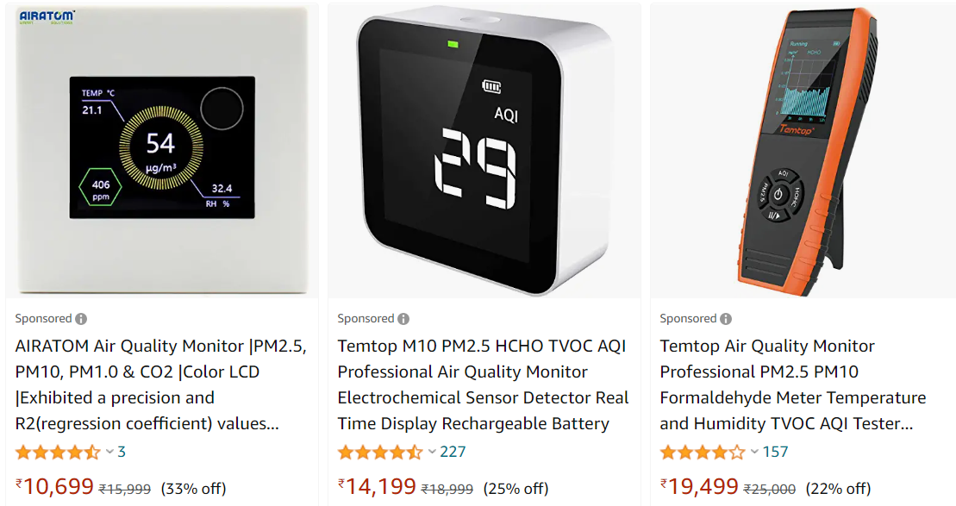
Existing Solutions
Similar Air Quality Monitoring Systems are available in market today. It monitors the various air conditions and display air quality index on an LED along with other details.
But these are not affordable for most of the beneficiaries despite the air quality being a significant factor that contributes to the health of a person.

Slide 6
Adoption Barriers
Since the product is to be used by most people, it should be easy to use and should not involve any complex operations from the side of the beneficiary.
The product should be small and easily installed.
The product should be affordable for a significant percentage of the beneficiaries.

Slide 7
Value Proposition
Our Value Proposition is for Hospitals, Industries, Malls, Schools, Colleges who need to be aware of the air quality in the facility. The Air Quality Monitoring System is an IoT system with moisture, temperature sensors and gas sensor using cloud and webpages. It has an easy-to-use and simple to install design at an affordable price.

Slide 8

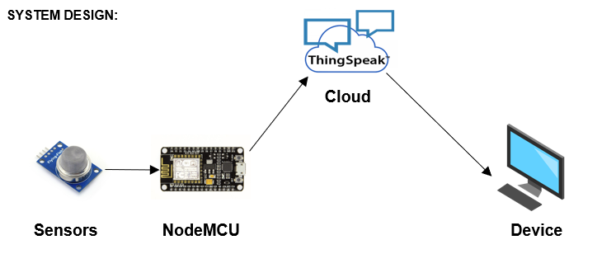
Solution Concept (MUP)
The sensors read the data and send signal to the NodeMCU which in turn sends it to the Cloud. The Cloud then stores this data. The device accesses the ThingSpeak Cloud using an API and displays the data in an easy-to-understand format on a webpage. The device also displays alerts if the data falls out of the range of safe values.

Slide 9
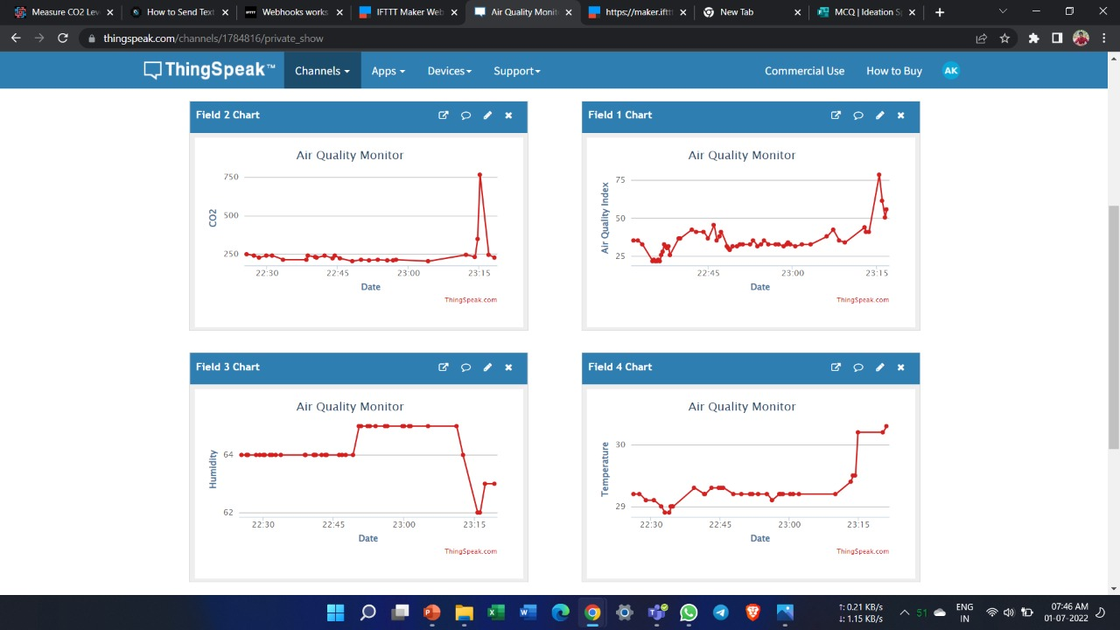
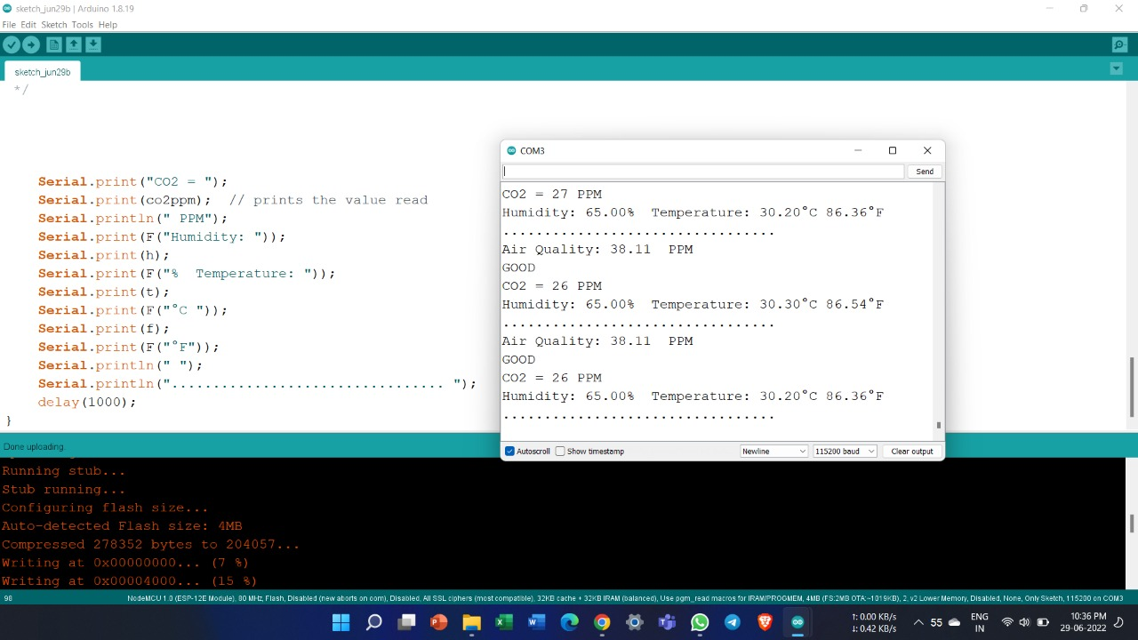
Solution Concept (MUP)

Slide 10
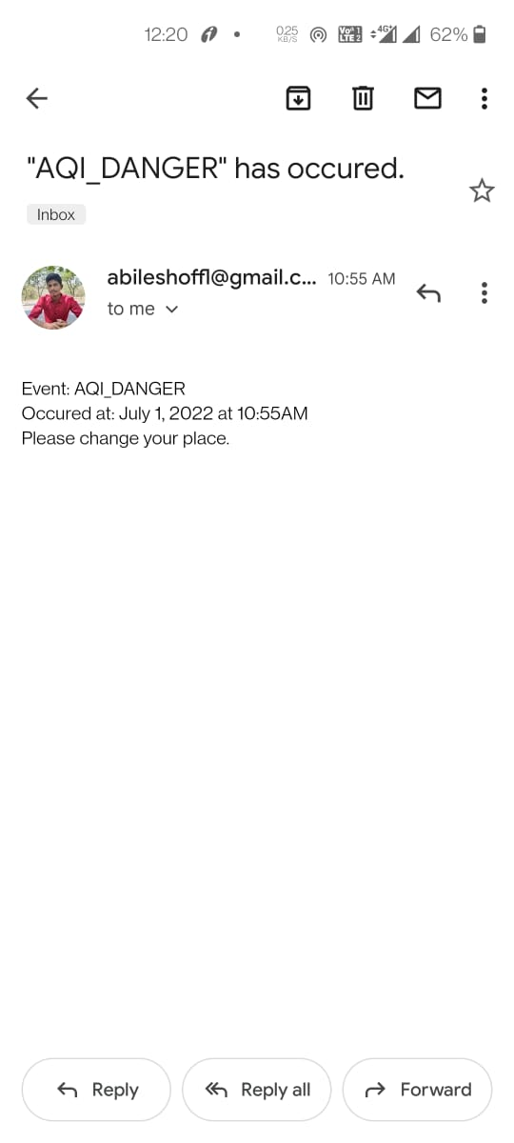
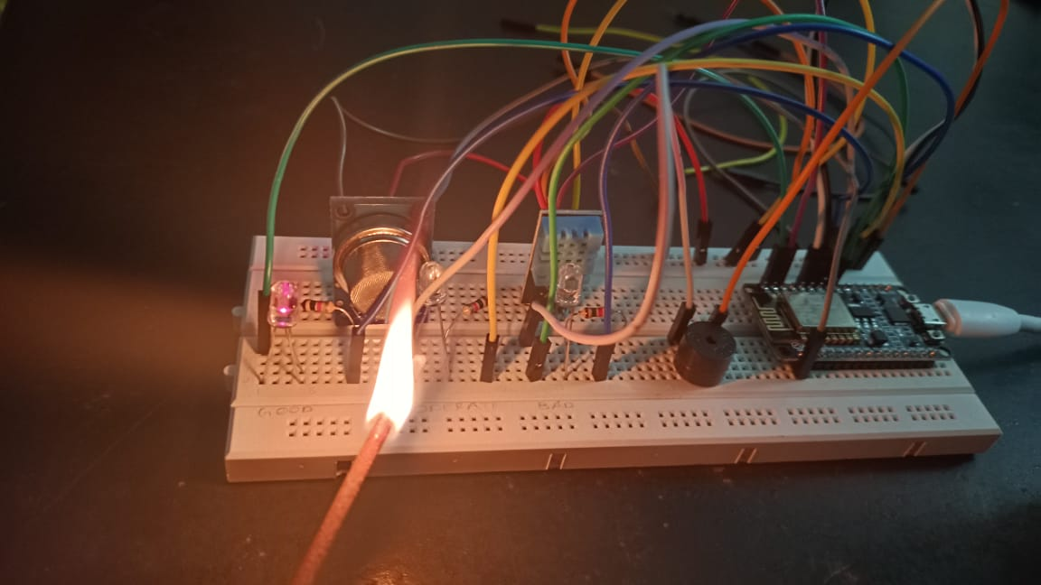
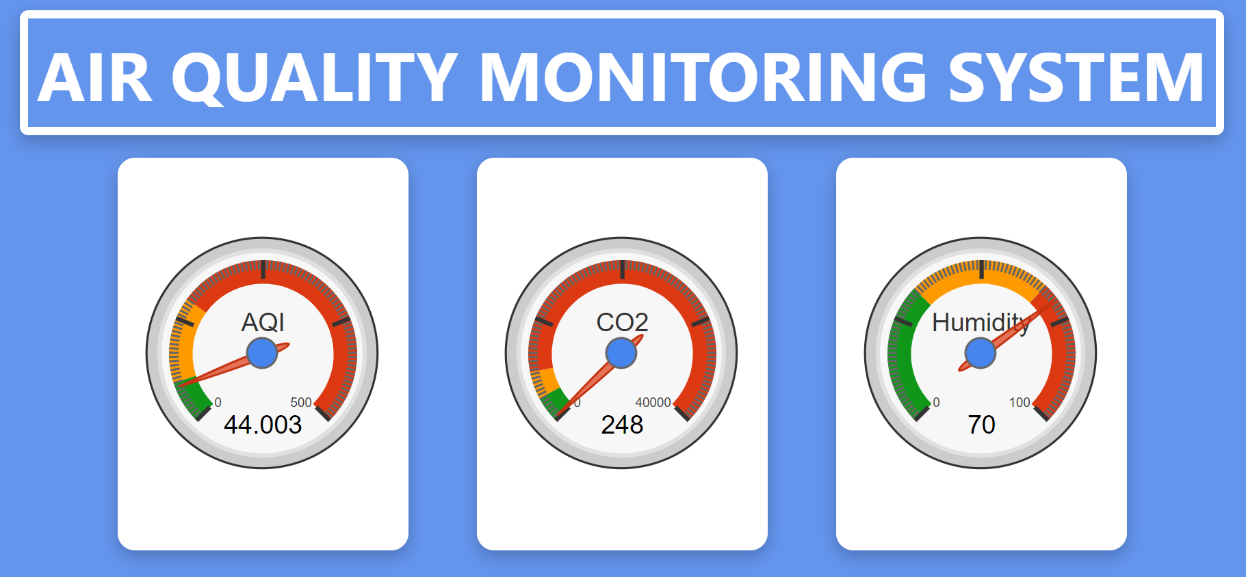
Solution Concept (MUP)

Slide 11
Next Steps
Further develop the product to achieve:
Minimal cost
Improved reliability
Additional information

Slide 12
Thank You

